Slide 1

Second Annual General Meeting
Allard Homeowners Association
September 27, 2022
Notes:
2 min
>>>> Add website address
>>>> Add map
https://docs.google.com/spreadsheets/d/1DOFr4uCRdyw71XIuOE1jQc0TIeO6Owehy0YQyuej9l8/edit?usp=gmail
https://docs.google.com/spreadsheets/d/1DOFr4uCRdyw71XIuOE1jQc0TIeO6Owehy0YQyuej9l8/edit?usp=gmail
https://docs.google.com/spreadsheets/d/1DOFr4uCRdyw71XIuOE1jQc0TIeO6Owehy0YQyuej9l8/edit#gid=546921390
https://docs.google.com/document/d/1CpqDUSeUYz9WFMCk66s0hEsDaUTYR5LFtKMJj9hmXZQ/edit

Slide 2

AGENDA
Opening - Call to Order
Introduction of Current Board Members
Appointment of Recording Secretary and Presiding Member
Registration of Attendance
Confirmation of quorum (10 or more persons entitled to collectively cast 10 or more votes)
Discussion on the Association’s function in the community with Ruth Wong-Miller (City of Edmonton Neighborhood Resource Coordinator)
Annual Report (review and discuss the annual report of the President)
Discussion on landscaping in the community
Questions from the Q&A
Appoint the auditors or accountants of the Association for the ensuing year
11. 12. Election of the Board of Directors:
  President:
  Vice-President:
  Secretary:
  Treasurer:
  Other:
Note the Board must contain a minimum of 3, and a maximum of 7 members.
13. Further business, if any
14. Conclusion / Adjournment.
Notes:
2min
Introduction (Jon)
Call to order and appointment of recording secretary (Chris)
Report of Interim Board (Chris)

Slide 3
The President resides
Notes:
6min

Slide 4
Introduction of Current Members
President: Mike Moran – up for re-election
Vice President: Hiep Ngo – up for re-election
Treasurer: Jacky Tsui – stepping down - Vacant
Secretary: Melissa Carnes – up for re-election
Director: Lucas Lau – up for re-election
Director: Francis Lam – up for re-election
Director: Vacant
Notes:
6min

Slide 5
Appointment of Recording Secretary and Scrutineer
Melissa Carnes to act as Recording Secretary
Michelle Antonyshyn to act as Scrutineer for the Meeting
Notes:
15min – (1-2 min per board member) + 2min tro
4 - Election of Directors
Board members
Overall board structure
1 slide per person

Slide 6
Scrutineer’s Report on Attendance
Record attendance virtually or by telephone
Confirmation of quorum (10 or more persons entitled to collectively cast 10 or more votes)
Notes:
15min – (1-2 min per board member) + 2min tro
4 - Election of Directors
Board members
Overall board structure
1 slide per person

Slide 7
Quorum
Meeting Regularly Constituted
Notes:
15min – (1-2 min per board member) + 2min tro
4 - Election of Directors
Board members
Overall board structure
1 slide per person

Slide 8
Association’s Function in the Community
Ruth Wong-Miller - City of Edmonton’s Neighbourhood Resource Coordinator will present a presentation on the association's function in the community
Notes:
15min – (1-2 min per board member) + 2min tro
4 - Election of Directors
Board members
Overall board structure
1 slide per person

Slide 9
Community Leagues
Community Leagues are created at the initiative of residents with support from the EFCL and the City of Edmonton.
Membership is by choice and is open to any resident within the geographic boundaries of the community league
Community Leagues are generally between 5000-20000 residents
Purpose includes:
  providing recreation and cultural programs for residents,
  affiliating with local sport zones (i.e. Edmonton Minor Soccer),
  contributing to developing local public parks (i.e. playground)
  Being a voice for the community to address community concerns and liaise with developers.
Notes:
15min – (1-2 min per board member) + 2min tro
4 - Election of Directors
Board members
Overall board structure
1 slide per person

Slide 10
Community Leagues & Homeowner Association
Similarities:
Both incorporated as non profit societies
Provide social events to bring neighbors together
Both develop parks spaces and playgrounds
Both maintain facilities and the rental of facilities
Both have programs for families
Both send out newsletters
Differences:
HA -Membership may be mandatory and dependent on caveats on properties
CL - Voluntary membership and members can vote to change boundaries
HA – Boundaries are focused on a part or single neighborhood
CL – Boundaries are focused on one or more neighborhoods
HA – Oversees the upkeep of private properties
CL- Maintain public land where league has a license to build amenities.
CL - Offers sports, youth, & senior programs
HA – Ensures the development standards
HA – Provide enhancements to the area
Notes:
15min – (1-2 min per board member) + 2min tro
4 - Election of Directors
Board members
Overall board structure
1 slide per person

Slide 11
Population Statistics
Neighbourhood | 2016 Census | 2019 Census | NSP Projected Pop.
Allard | 3133 | 6847 | 8720
Cavanagh | 0 | 956 | 5178
Cashman | 0 | 0 | 540
Callaghan | 3559 | 4000 | 5726
Blackburne | 1410 | 1424 | 1939
Richford | 758 | 823 | 1893
Blackmud Creek | 2763 | 2777 | 2656
Desrochers | 0 | 1133 | 5778
Totals | 11623 | 17960 | 32430
Notes:
15min – (1-2 min per board member) + 2min tro
4 - Election of Directors
Board members
Overall board structure
1 slide per person

Slide 12
Emergency League Process
BUILD STEERING COMMITTEE
FIRST SC MEETING
FIRST PUBLIC MEETING
INTERIM COMMITTEES
SECOND PUBLIC MEETING
COMMITTEE WORK
PLAN AGM
HOST AGM
Notes:
15min – (1-2 min per board member) + 2min tro
4 - Election of Directors
Board members
Overall board structure
1 slide per person

Slide 13
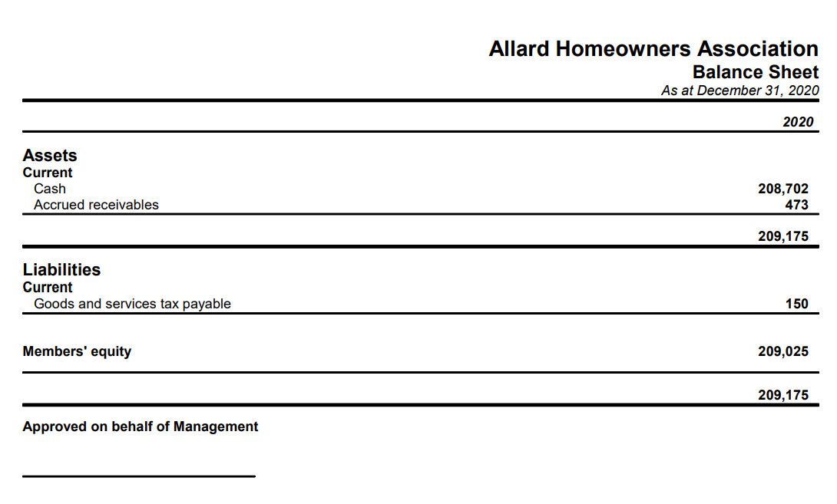
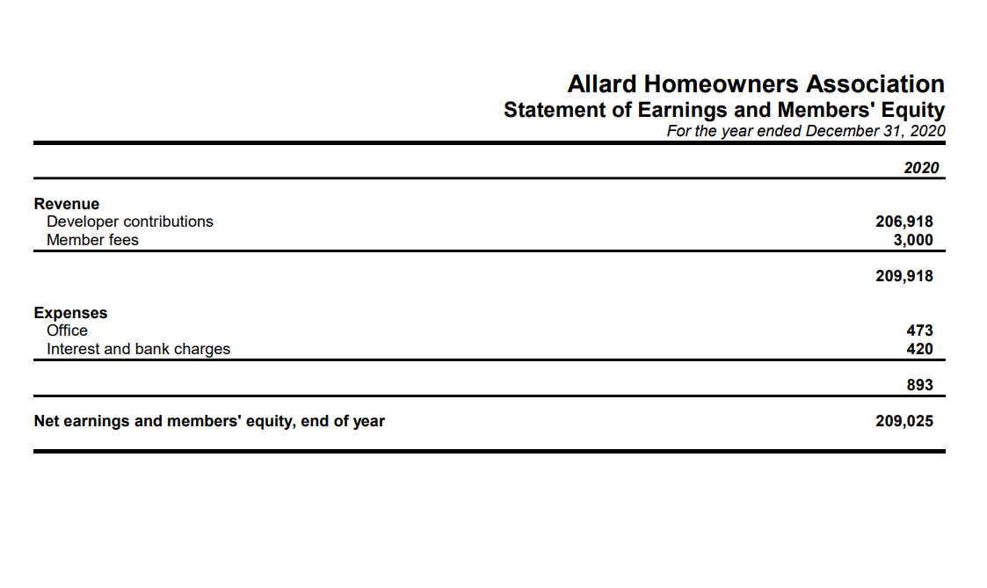
2020 Financial Statements
Notes:
5 min
Financial – TBC
Can we actually change the current financial slide to high level expenses breakdown and show the community how their HOA fee is being calculated?
Just a thought, because the community should have over 1000 houses and they would want to know why do they need to pay that much and how much did they actually get spent.
~Flora

Slide 14
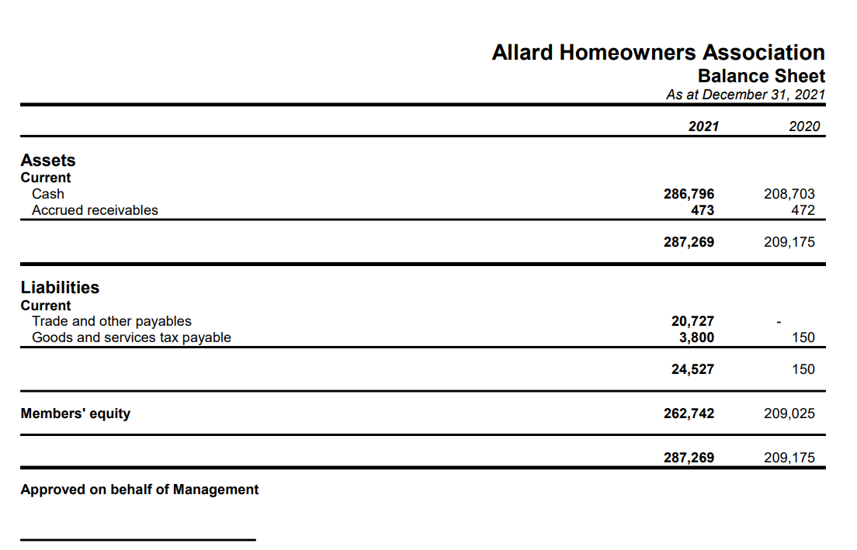
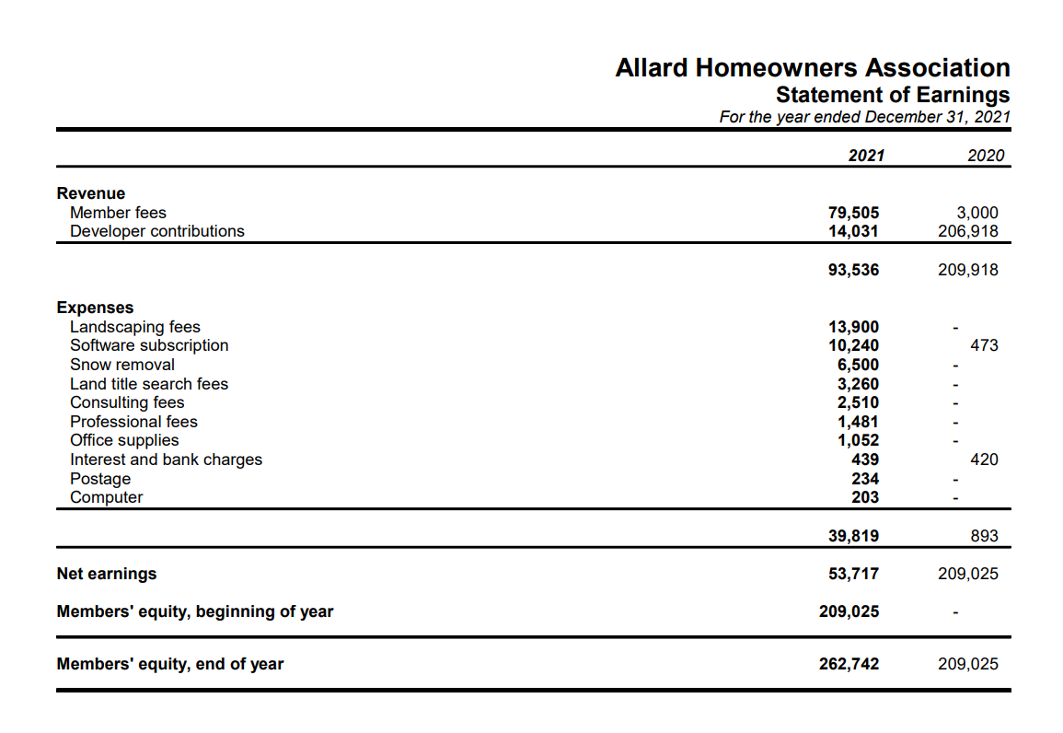
2021 Financial Statements
Notes:
5 min
Financial – TBC
Can we actually change the current financial slide to high level expenses breakdown and show the community how their HOA fee is being calculated?
Just a thought, because the community should have over 1000 houses and they would want to know why do they need to pay that much and how much did they actually get spent.
~Flora

Slide 15
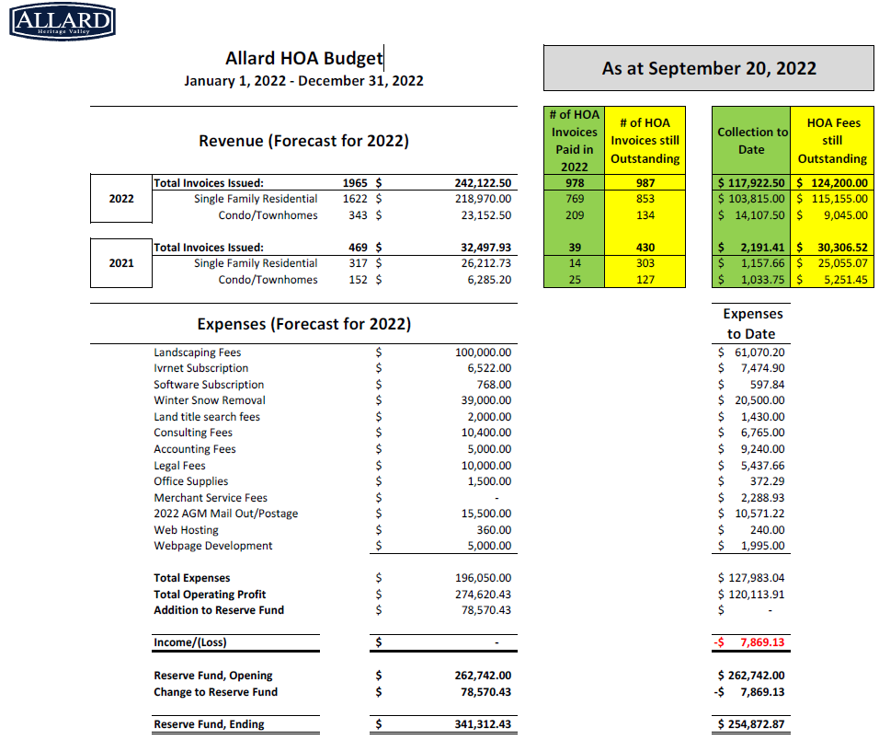
2022 YTD Financial Statements
Notes:
5 min
Financial – TBC
Can we actually change the current financial slide to high level expenses breakdown and show the community how their HOA fee is being calculated?
Just a thought, because the community should have over 1000 houses and they would want to know why do they need to pay that much and how much did they actually get spent.
~Flora

Slide 16
Discussion of the Report of the President
Summary of the Report
  Ice rink
Recent Resident Topics:
  Landscaping
  Insurance
  Fee collections
Q&A - Open to group for discussion

Slide 17
Financial Appointments
Appointment of the association’s accountant for the following year
Appointment of auditors

Slide 18
Election of Directors
Fixing the number of positions on the Board of Directors
Election of Directors – only members in good standing may be nominated
Board of Directors
Vice-President
Secretary
Treasurer
Director
Director
Director
President

Slide 19
Further Business/Adjournment
Floor opened for any further questions or concerns that the board members may have.

